Slide 1



DERMAI
Pace University Capstone Project
By team Thunder Buddies

Slide 2
TABLE OF
CONTENTS
01.
06.
TEAM MEMBERS
TECHNOLOGIES
02.
07.
PROJECT STATEMENT
SPRINT SCHEDULE
03.
08.
PROJECT DESCRIPTION
TEAM WORKING AGREEMENT
04.
09.
MARKET ANALYSIS
RETROSPECTIVE
05.
PERSONAS

Slide 3
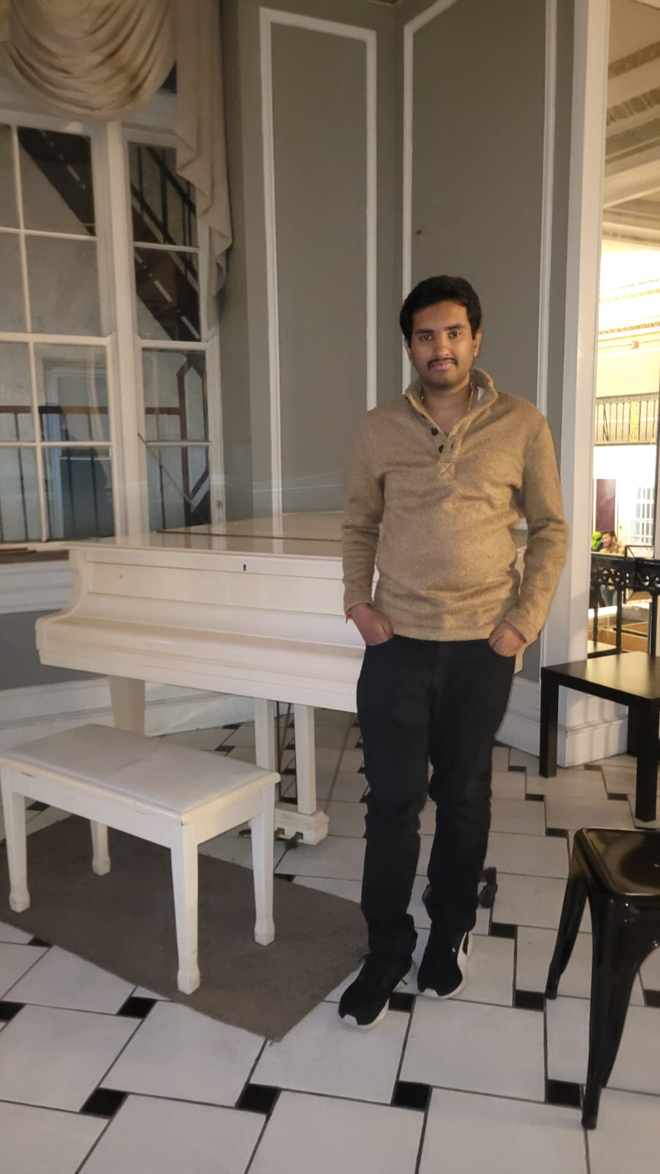
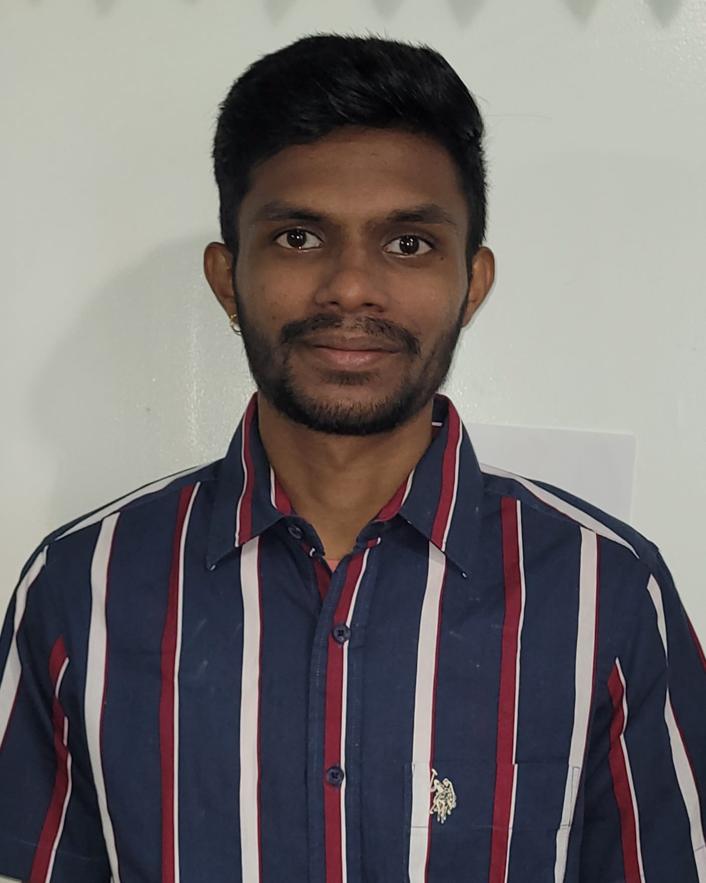
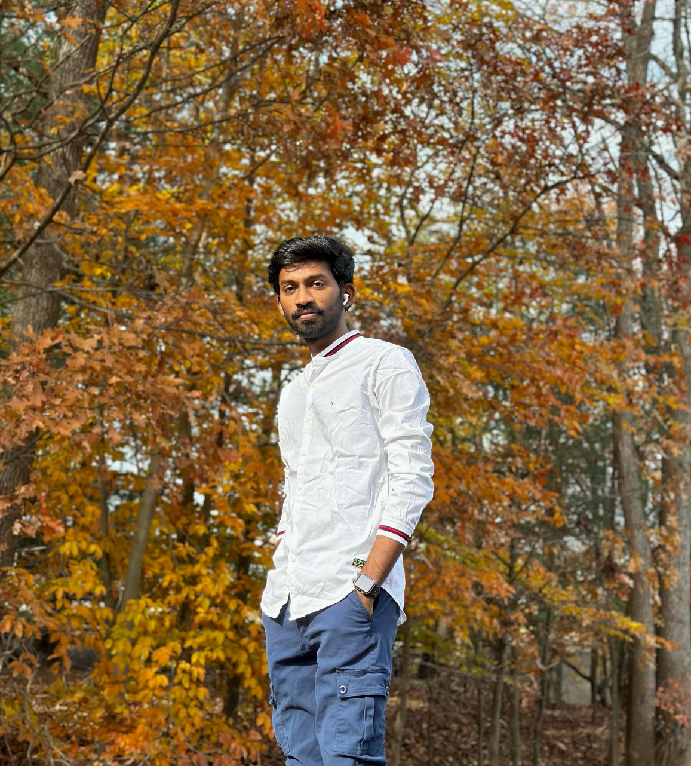
TEAM MEMBERS
Bhargava Chilukuri
Project manager
Kushal Arya Neela
Front end developers
Sai Praneeth Chagiri
Front end developers

Slide 4
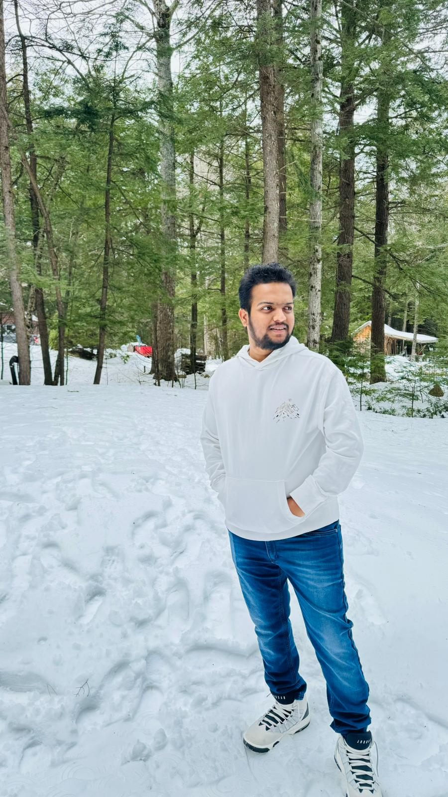
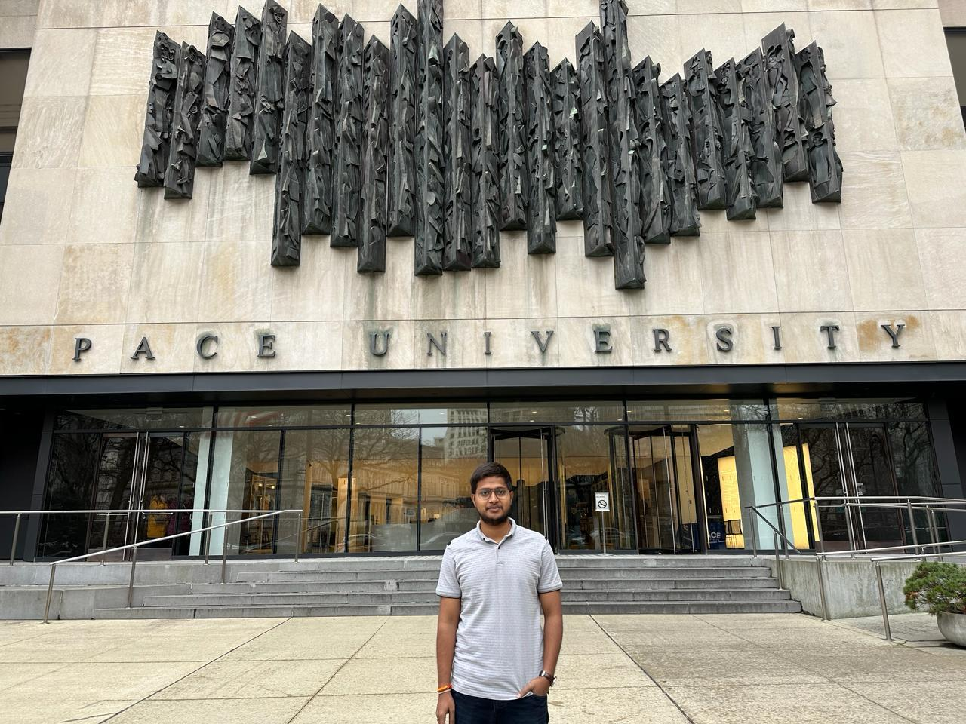
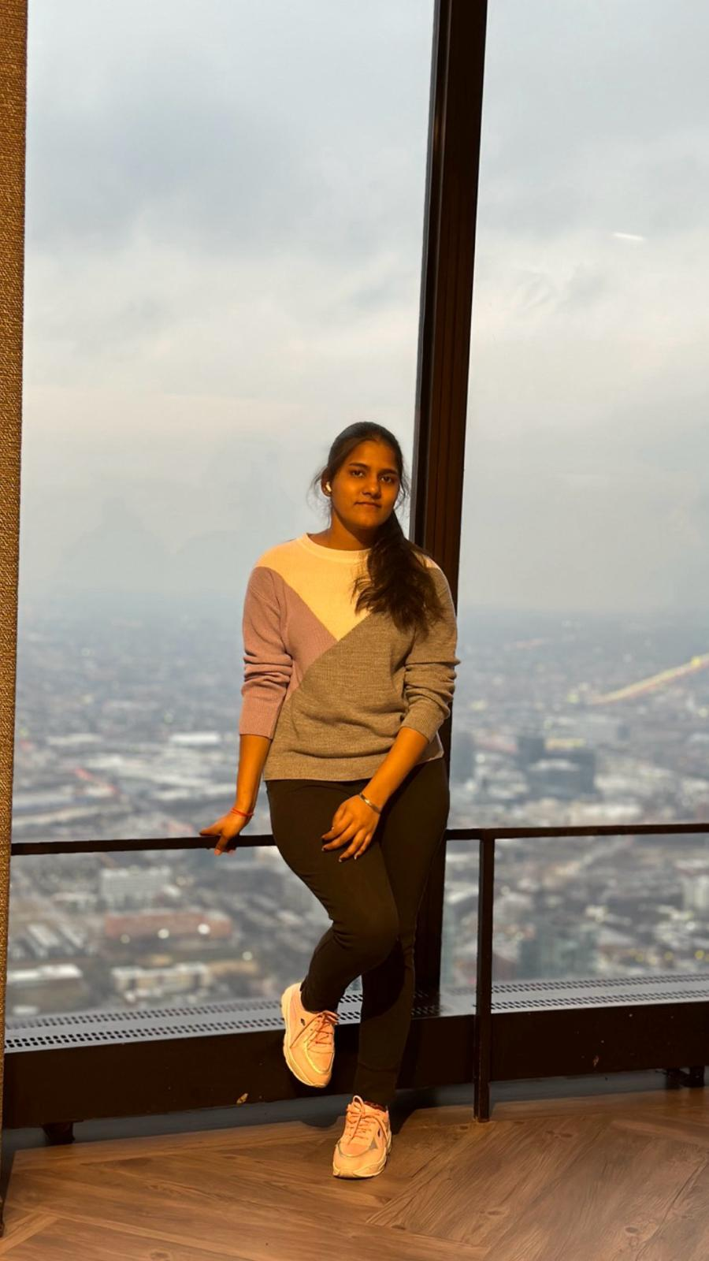
TEAM MEMBERS
Srinath Madagoni
Machine learning engineers
Manoj Kumar Madhavarapu
Machine learning engineers
Akshara Uppu
Backend developers

Slide 5
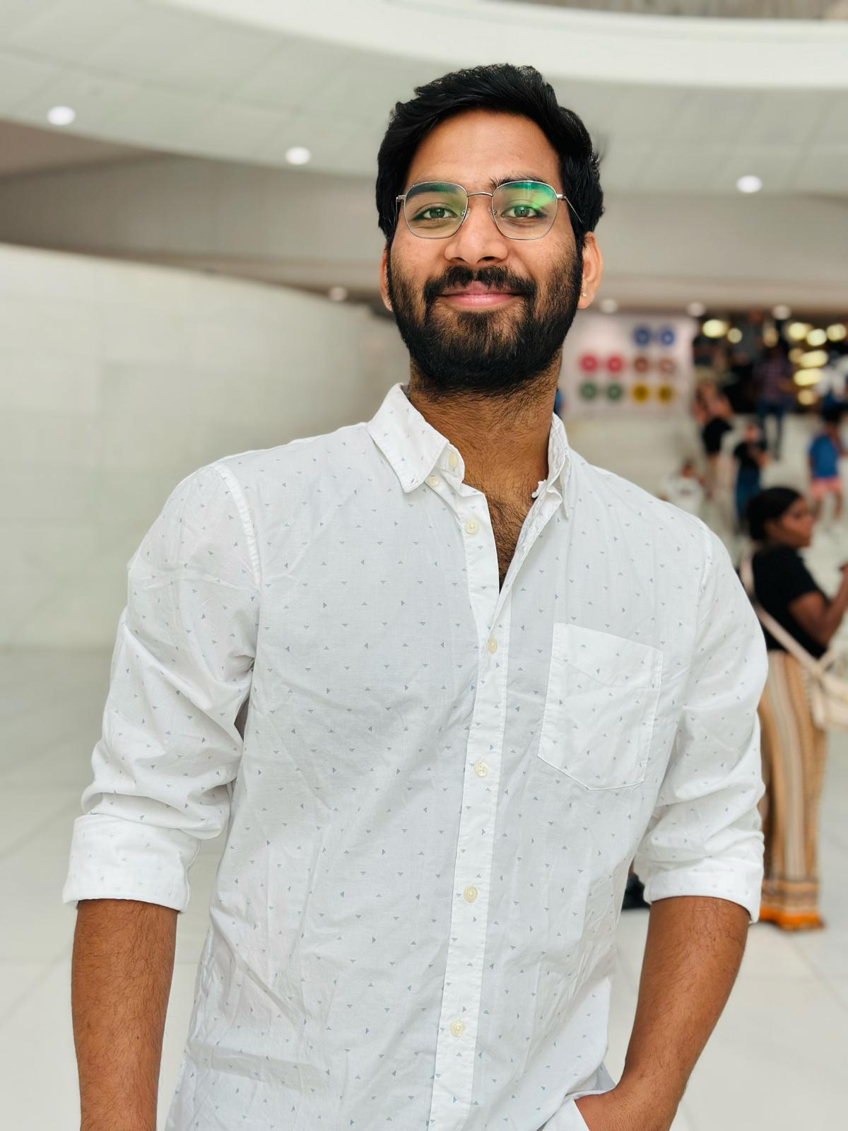
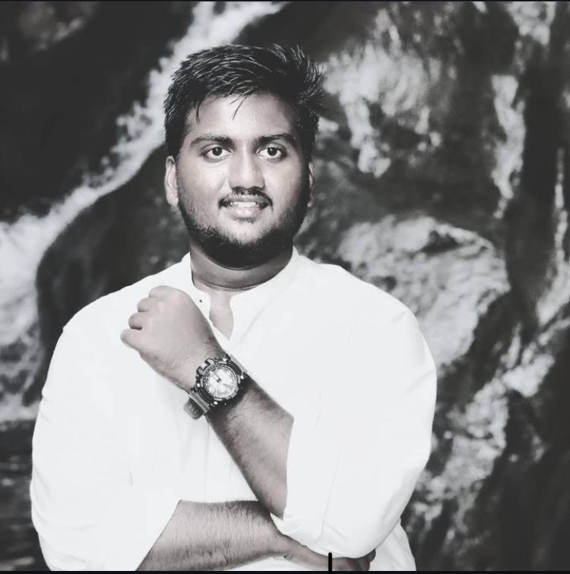
TEAM MEMBERS
Manideep Kumar Reddy Kotha
Backened developer
Jagadeesh Mekhapothula
Backened developer and QA tester

Slide 6
PROBLEM STATEMENT
The diagnosis of the dermatological problem is quite complex and it requires expert knowledge and even inaccurate results with no proper knowledge. At present digital solutions lack accuracy and simplicity usage of the application. Thus ,it creates a gap between the human solution and the digital solution. So DermAI comes in place which has a user-friendly interface and employs deep learning to diagnose skin conditions and give precision results. Which empowers everyone from general public to have expert dermatologists in their hands.

Slide 7
PROJECT DESCRIPTION
DermAI is a next-generation mobile Application that is designed to keep easy to use and get accurate diagnosis reports. It uses the latest deep learning model for detection of skin disease which powers the application. The Application is built with react native which gives a seamless cross-platform experience and the backend is supported by node js and flask. Use of TensorFlow is for deep learning and Firebase is used for authentication and database management. Digiocean is used for deploying the backend services to allow DermAI to give real-time results in dermatological reports.

Slide 8
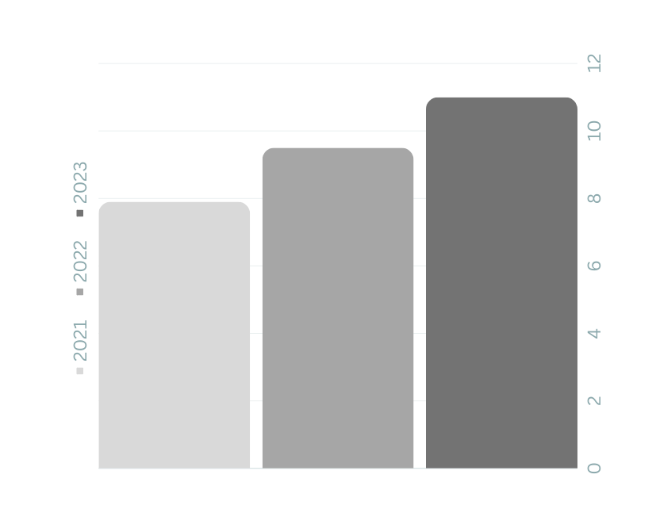
MARKET ANALYSIS
PEOPLE
MARKET
458K
With the raise of smartphones, DermAI targets a growing demographic where users who require preliminary analysis tools.
The teledermatology market is expanding and with CAGR of 16.3% by 2025
SALES
$752,000
Total revenue in 2022
86%
Market share in global

Slide 9

05.
PERSONAS

Slide 10

PERSONA 1
AGE: 29
OCCUPATION: CORPORATE LAWYER
TECH-SAVVINESS: HIGH
NEEDS: QUICK , RELIABLE SKIN
CONDITION CAUSED DUE TO HER BUSY WORK AND SCHEDULE.
PAIN POINTS: LACK OF TIME TO VISIT DERMATOLOGISTS AND NEED FOR IMMEDIATE ADVICE ON SKIN CARE.
EMMA
THE BUSY PROFESSIONAL

Slide 11
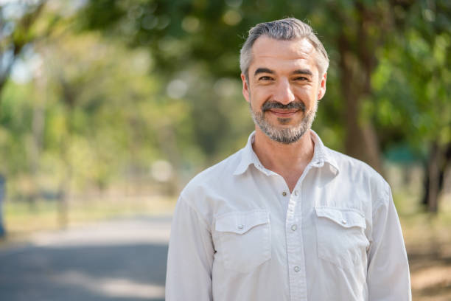
PERSONA 2
AGE:45
OCCUPATION: FARMER
TECH-SAVVINESS: MODERATE
NEEDS: EASY ACCESS TO THE DERMATOLOGIST CARE, THE NEAREST CENTRE IS FEW HOURS AWAY
PAIN POINTS: GEOGRAPHICAL ISOLATED LOCATION AND RARE COMMUTE TO THE CITY MAKES IT DIFFICULT FOR REGULAR CHECKUPS AND SKIN CARE.
DAVID
THE RURAL RESIDENT

Slide 12
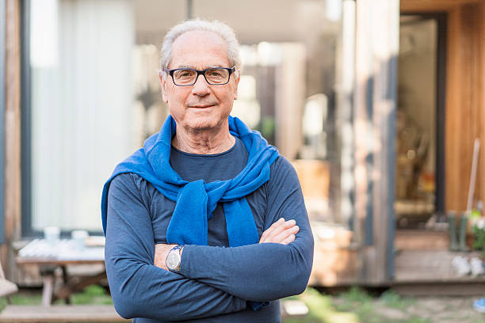
PERSONA 3
AGE:70
OCCUPATION: RETIRED
TECH-SAVVINESS: LOW
NEEDS: SHOWS EASE TO USE INTERFACE FOR CHECKING SKIN CONDITIONS.
PAIN POINTS: PREFERS SIMPLICITY AND EASE IN TECHNOLOGY, OFTEN CAUTIOUS ABOUT TRYING OUT NEW DIGITAL AND AI TOOLS.
MICHAEL
THE SENIOR CITIZEN

Slide 13







TECHNOLOGIES
-d
Flask
Firebase

Slide 14
SPRINT 1 SCHEDULE
Tasks | Time
Project Idea and description | 4 days
Finalizing roles | 1 day
Tech stack | 3 days

Slide 15
RETROSPECT
WHAT WENT WELL:
WHAT CAN BE IMPROVED:
ACTION ITEMS:
Active Communication among team members
Regular Scrum meetings
Quick roles and Result based decisions
Being more efficient in critical points of the project
Team building skills
Comprehensive analysis in further sprint meetings
Making and implementing realistic goals
Raising questions and further discussion about project analysis

Slide 16
WIKIPAGE

Slide 17
TEAM WORKING AGREEMENT
Team Name
Team Purpose:
Our goal is to bring collaborative knowledge and skills together for the completion of the Computer Science Capstone Project. Our project might have challenges to tackle and we will tackle those challenges and deliver the project on time.
Team Members:
1. Bhargava Chilukuri
2. Jagadeesh Mekhapothula
3. Sai Praneeth Chagiri
4. Kushal Arya Neela
5. Manideep Kumar Reddy Kotha
6. Manoj Kumar Madhavarapu
7. Srinath Madagoni
8. Akshara Uppu
Agreement
All teammates should share their opinions and even respect each other's opinions. The sharing of information should be transparent, if any of the team members is having any issue, they can react to other team members and try to solve the issue.
Team Members are responsible for their respective tasks and should deliver before the due date and if they are unable to finish it before the due date, they can reach out to other members.
All the roles are given based on your strengths and there shouldn't be any conflict between team members regarding roles.
Communication is key for success and weekly 2 meetings will be held one on Wednesday and the other on Saturday all team members should take part in the team meetings and all communications are done via Slack.
If any team member is unable to attend the meeting, then they have to prior inform the scrum master about it, and missing any team meeting is not advisable.
Missing more than 3 meetings will be informed to the professor.
All members should equally take part and give their best effort.

Slide 18

THANK YOU

